Slide 1
PGS SCM
- Version Control
PGS DEV
May, 2011

Slide 2
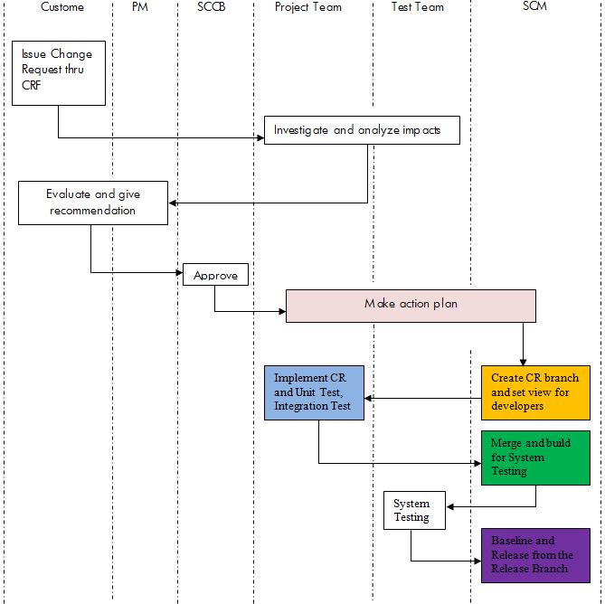
Overall Process

Slide 3
Roles, Privileges and Responsibilities
StarTeam Self Service Tool
https://useit.atlanta.hp.com/gcart/starteam/groups/Realm-PGS
Roles and Privileges (Realm-PGS)
PGS-user : Check in/out code, Merge Branches, Add files/folders
PGS-gatekeeper : Above + Create/Delete Branches, Delete files/folders, Add/Delete users
PGS-viewer : View only.
Responsibilities
Developers (PGS-user)
Perform development on specified branch and conduct code merge if necessary due to event triggers, for example MTT/MTP;
China Dev belong to this group except the SCM owner (Charlie).

Slide 4
Roles, Privileges and Responsibilities
Responsibilities
SCM Owner (PGS-gatekeeper)
Create/merge branches due to event triggers, for example new project, MTT/MTP activities;\
Delete branches/folders/files to keep stuffs in StarTeam clean, this should be strictly limited;
SCM owner: Charlie, Jiaxi, Amy, Greg, Richard.
Others (PGS-viewer)
View only;
None in this group so far.

Slide 5
Branch and Merge
Triggers
branching for new project or exceptions like emergency fix
merging for MTT, MTP activities
Action
PM/PL/Developers: submit branching request
SCM Owner: create branches
Types of Branch
Main Branch : the root branch where other branches will merge back when the MTP is done.
Dev Branch : used for routine bug fix and enhancements.
Project Branch : only used for project related development.

Slide 6
Branch and Merge
Naming conventions
Main Branch: NA
Dev Branch: Branch.Dev.[Component]
Project Branch: Branch.[Project].[Component]
MTP Label: Release.[MTP Date]

Slide 7
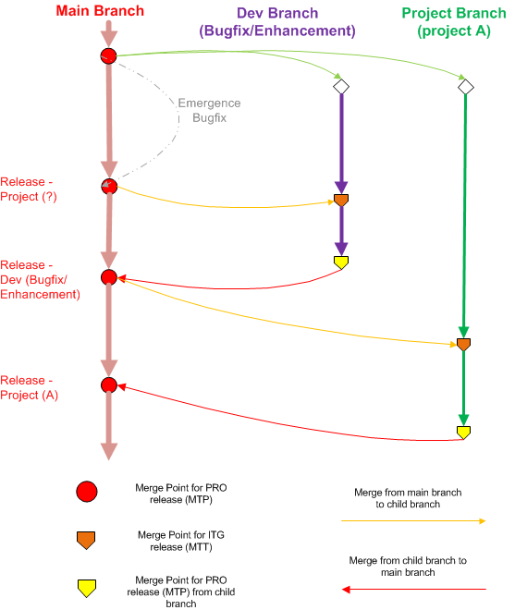
Branch and Merge
Solution
1. Categorize Branches
Main branch for MTP
Dev Branch for routine bug fix and maintenance
Project Branch for project development
2. MTT build packages should be generated from child branch
3. When generating MTT build packages on child branch, need to merge code from main branch first if there is a MTP already happens on main branch
4. When child branch reaches the development end, it should merge code from main branch first if there is a MTP already happens on main branch, and then merge the final code back to main branch when MTP build package is generated.

Slide 8
Q & A?

